Slide 1
Day 18
Combining Uncertain Measurements

Slide 2
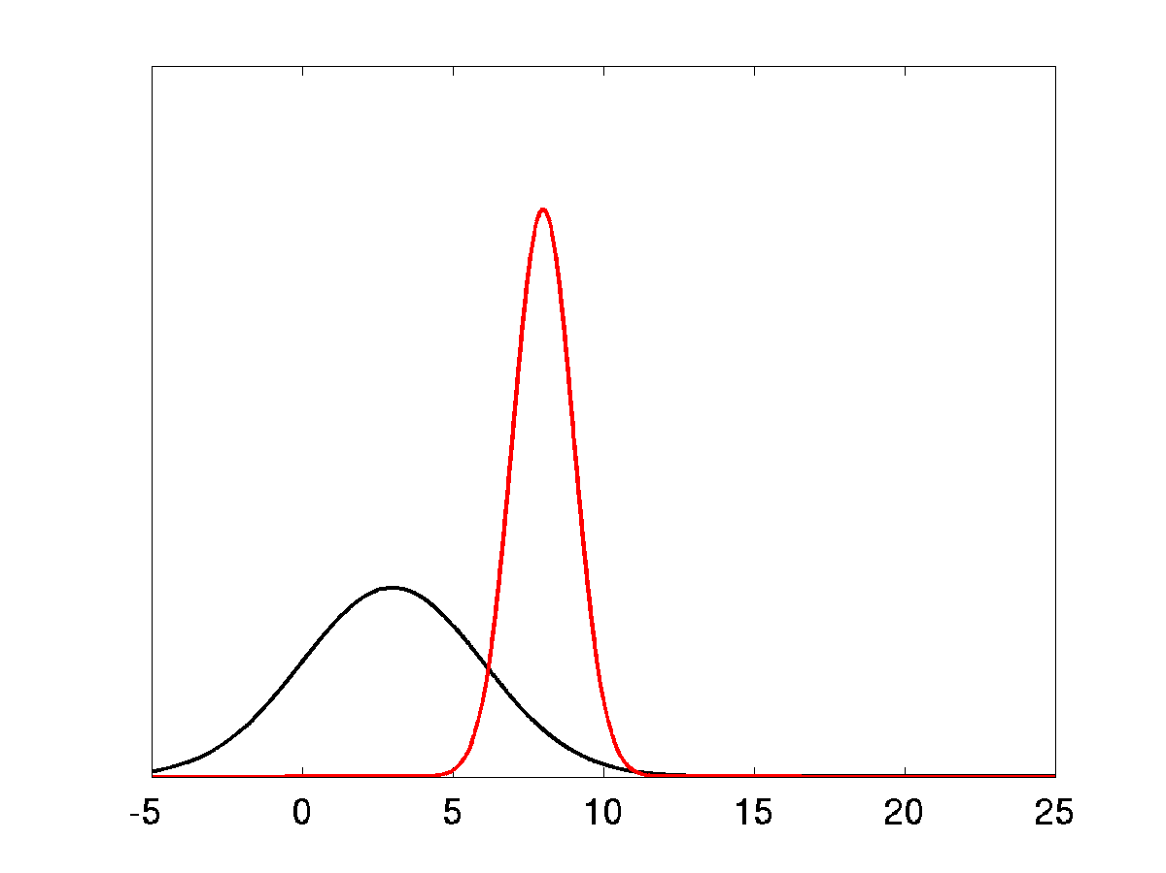
Lost at Sea Example

Slide 3
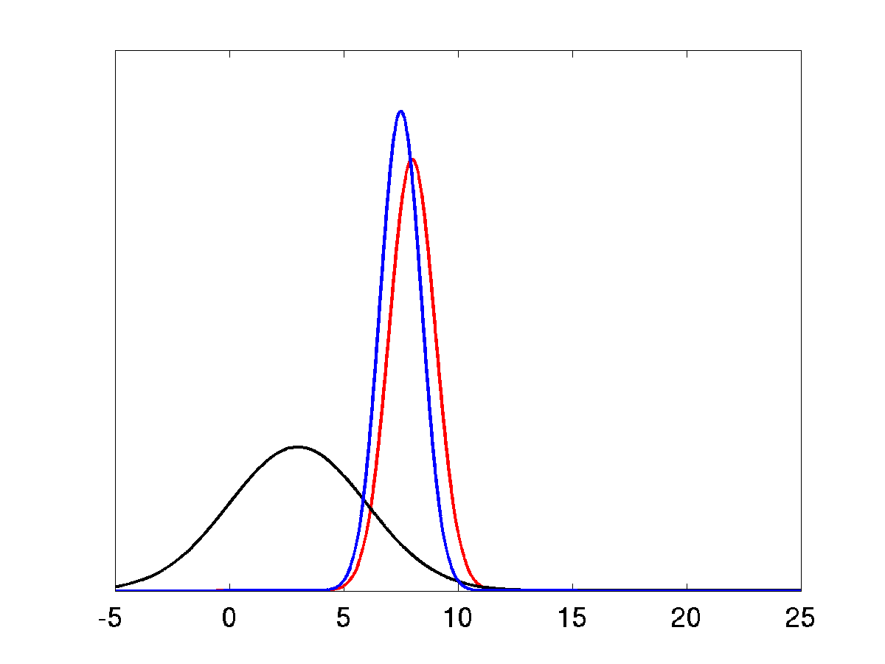
Lost at Sea Example

